Slide 1
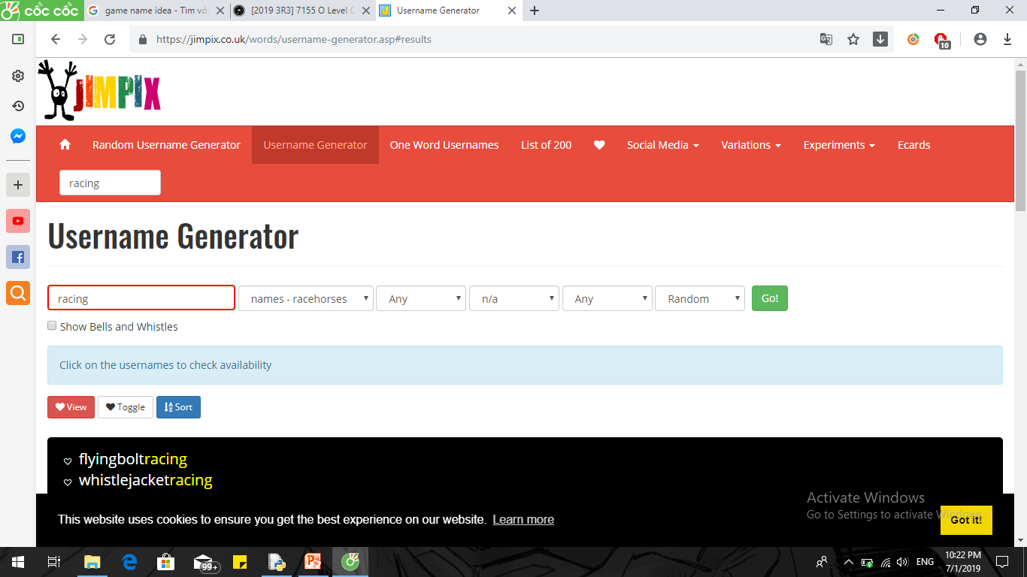
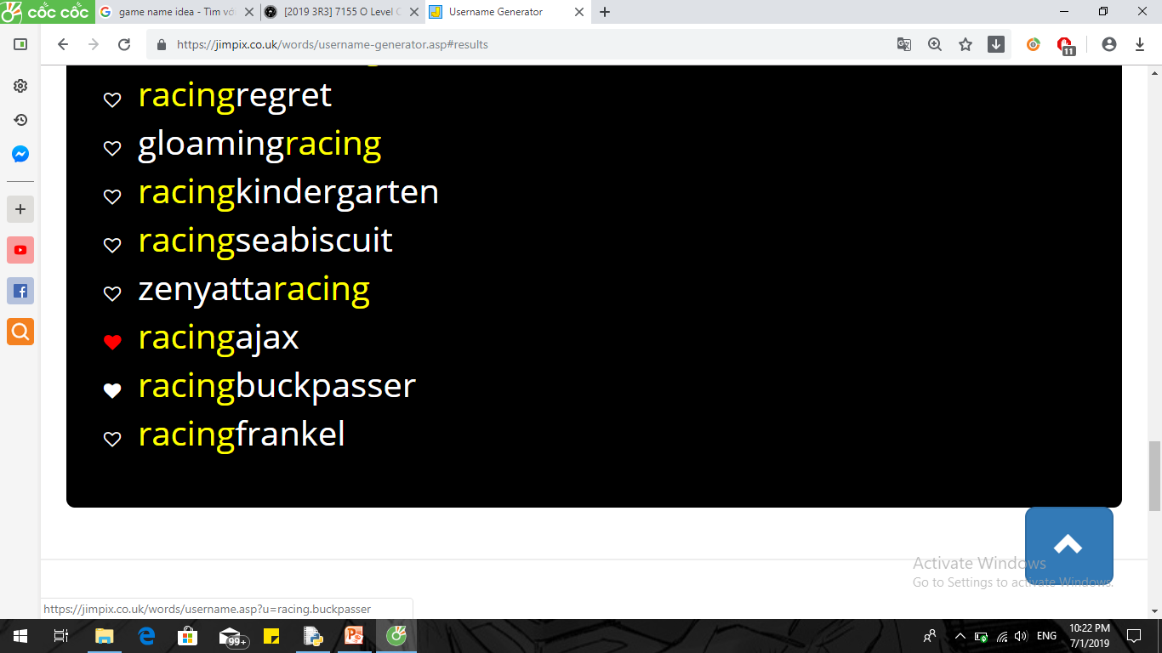
Game idea
Name: Racingajax

Slide 2
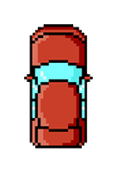
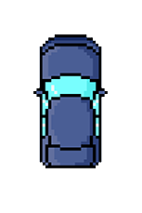
Game idea
Category: racing game (avoid obstacles)
Character:
Main character
Obstacle

Slide 3
Game idea
Coding: using pygame
Function
While loop
If – else statement
Extra: random, time library
Work basically on shifting place of objects

